Slide 1
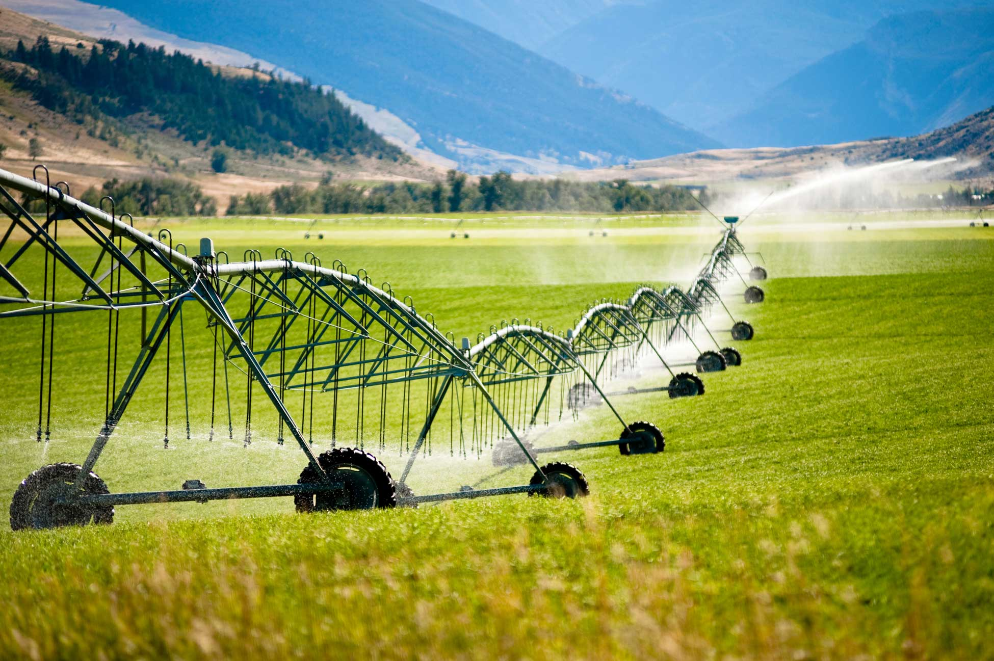
Irrigation Methods Water Usage in the United States and Techniques to Ensure Water Efficiency
Image (1)
Marcos Andrade
November 29th, 2022

Slide 2
Research Question and Background
Irrigation Methods Water Usage in the United States and Techniques to Ensure Water Efficiency
Congressional Research Service and United States Geological Survey
Water usage is an important topic in actuality due to the scarcity of resources
“Irrigation has played a significant role in the development and economy of the United States. It was critical in the settlement of the West and agricultural reinvention after the Dust Bowl” (9)

Slide 3
What dataset did you use?
Data comes from field studies, interviews made to specialists and shared research. It comes directly from the United States Geological Survey (USGS)
Original dataset was contained in a 3225 x 141 table
3225 observations within 141 variables
Dependent variables were acres irrigated and water used per day
Explanatory variables were states and counties
Analyzed variables were categorical
The initial hypothesis is that water usage will be consistent throughout all categories

Slide 4
Methods
Tidy data
Original dataset had no mistakes in general, and good practices for data format were used (glossary, camel casing, one piece of data per cell
Data was not necessarily reproducible; possible to reproduce but not feasible
Pivot tables were used, sum of data and graph insertion. Used excel with practices learned at class.

Slide 5
Results

Slide 6
Figure 1

Slide 7
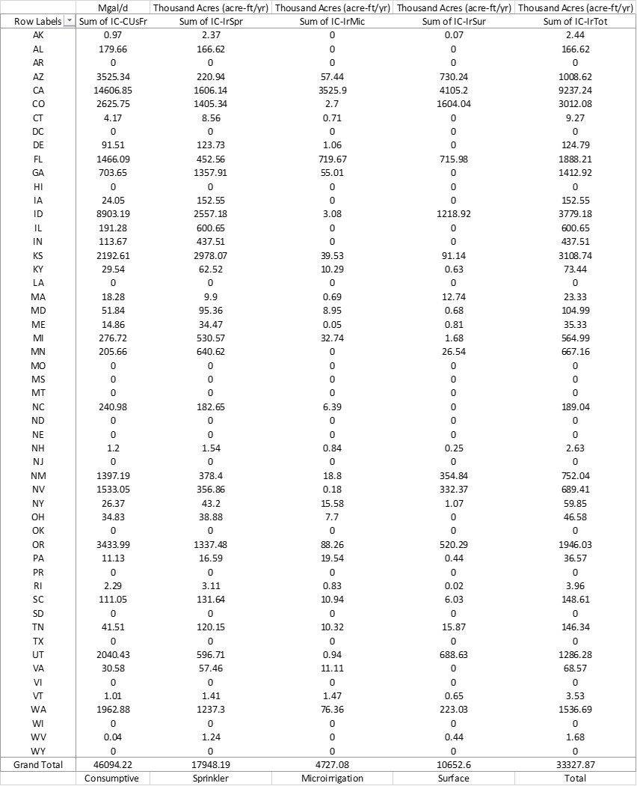
Figure 2

Slide 8
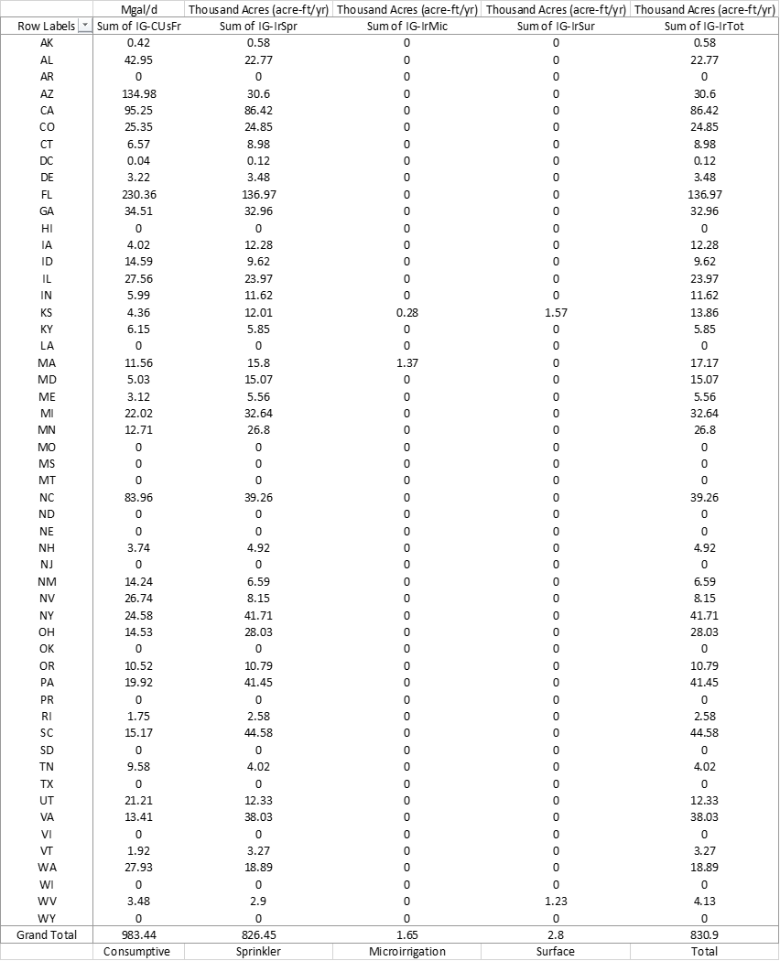
Figure 3

Slide 9
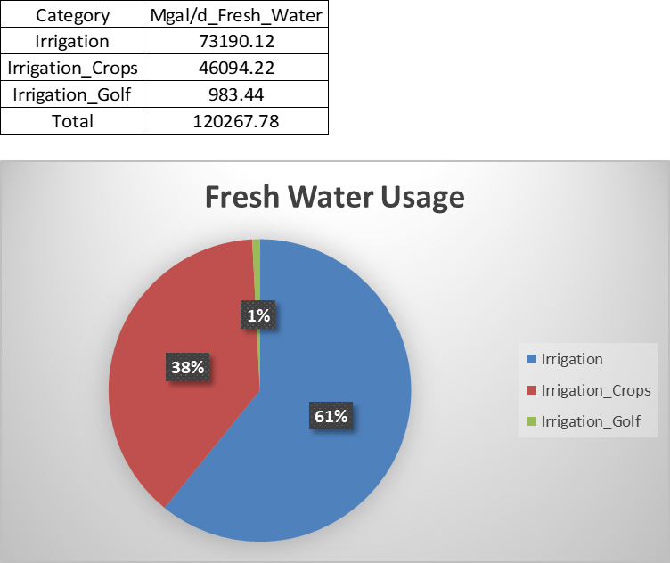
Figure 4

Slide 10
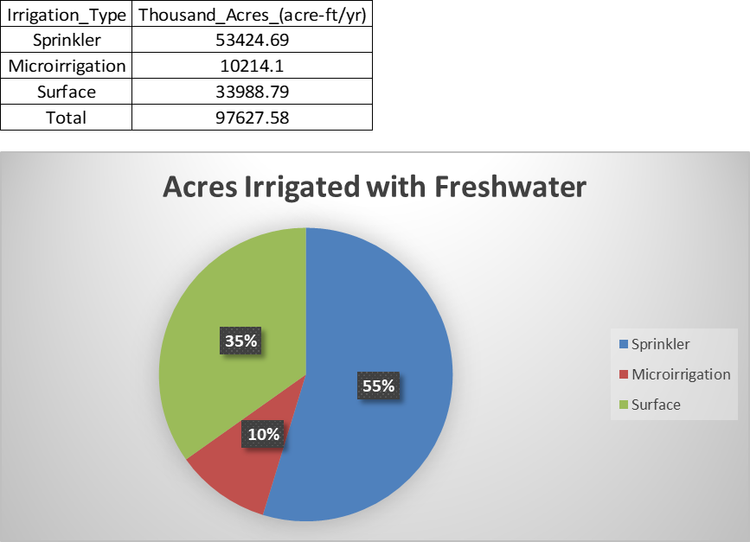
Figure 5

Slide 11
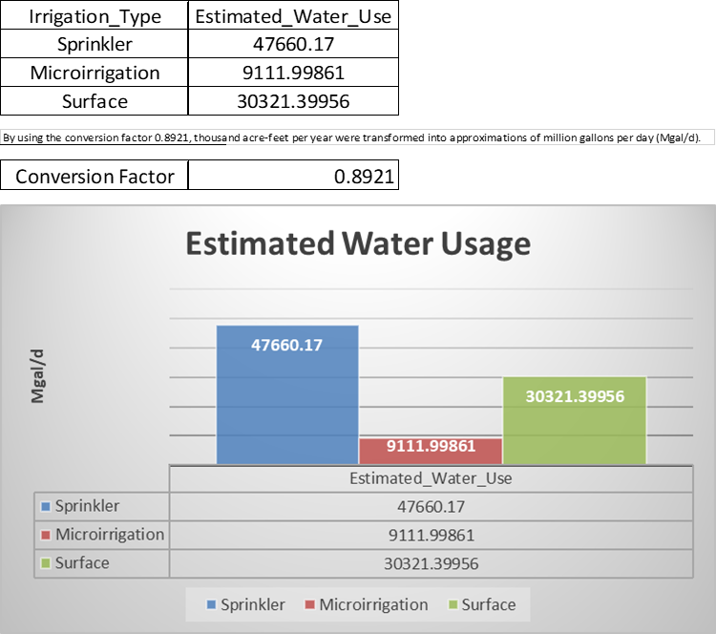
Figure 6

Slide 12
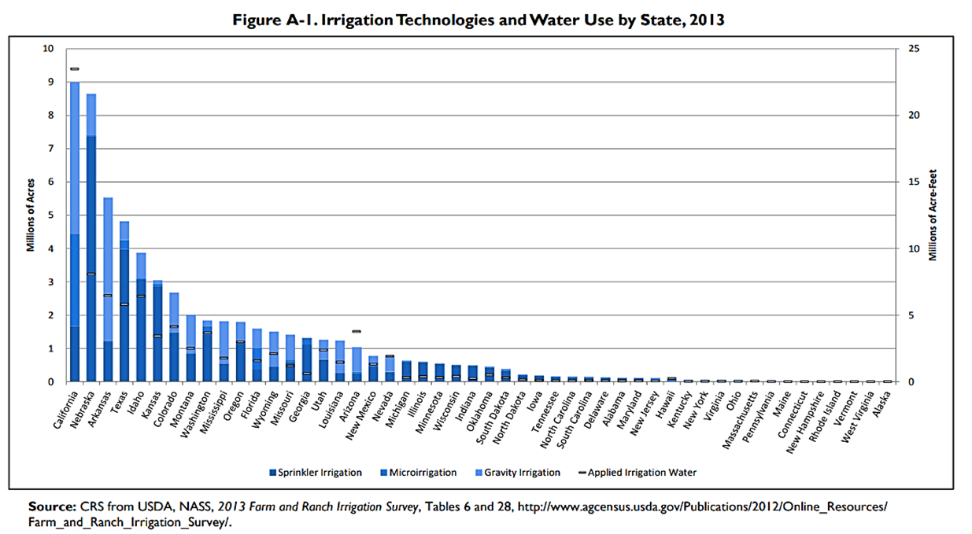
Figure 7 (9)

Slide 13
Discussion
Definition for multiple irrigation methods
Confirmed that data align for the most part with these water usage estimations
Discovered multiple irrigation efficiency practices
Interesting that even efficient methods can still be improved
Awareness in taking care of water in all aspects

Slide 14
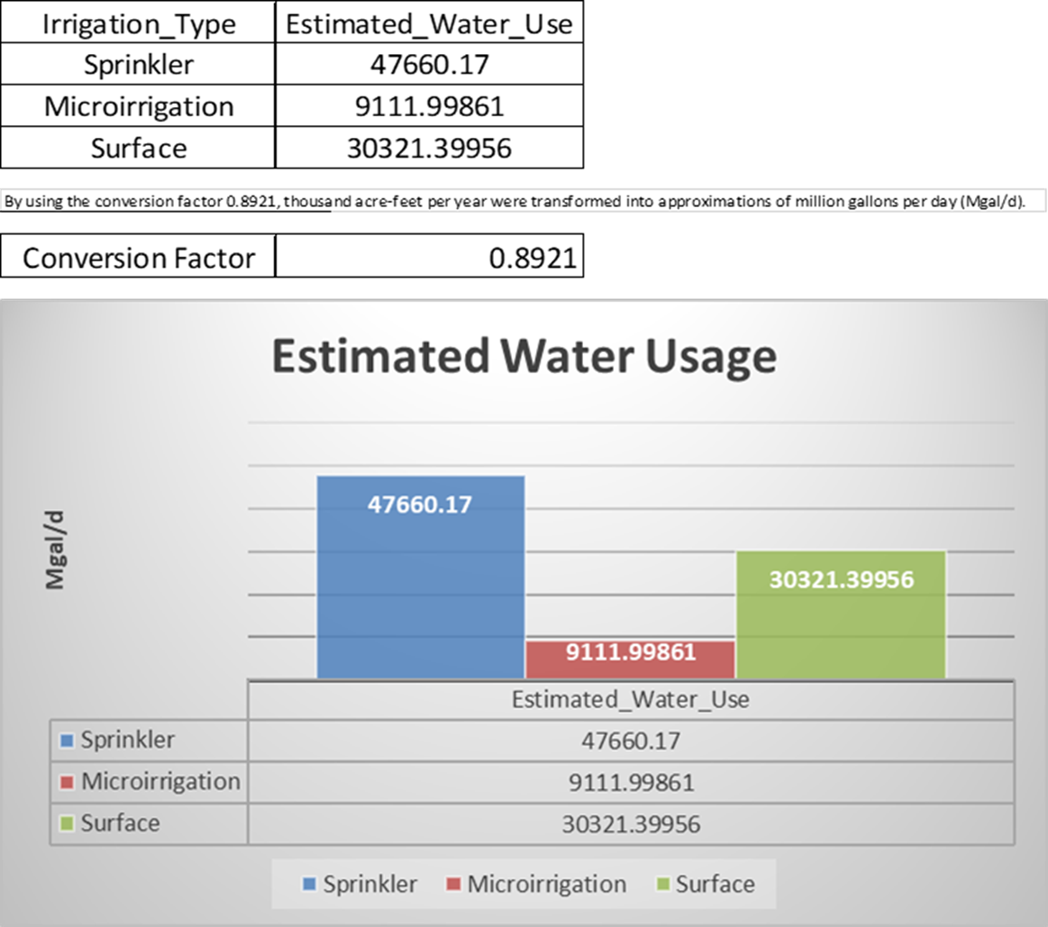
Conclusion
Sprinkler = 400 gph (6)
Microirrigation = 30 gph (6)
Surface = 800 gph (7)
Future studies about how to implement the previously mentioned irrigation efficiency practices can be done focusing attention prioritizing these three irrigation methods according to their water usage.

Slide 15
References
1. S. for a C. W. USGS, Estimated Use of Water in the United States County-Level Data for 2015 - ScienceBase-Catalog. www.sciencebase.gov (2017) Available at https://www.sciencebase.gov/catalog/item/get/5af3311be4b0da30c1b245d8 (November 5, 2022).
2. C. C. Shock, B. M. Shock, T. Welch, “Strategies for Efficient Irrigation Water Use” Available at https://catalog.extension.oregonstate.edu/em8783 (Oregon State University, 2013).
3. U.S. Bureau of Labor Statistics, Appendix D ‐ USPS State Abbreviations and FIPS Codes: U.S. Bureau of Labor Statistics. www.bls.gov (2005) Available at https://www.bls.gov/respondents/mwr/electronic-data-interchange/appendix-d-usps-state-abbreviations-and-fips-codes.htm (November 20, 2022).
4. UNICEF, Water Scarcity. UNICEF Available at https://www.unicef.org/wash/water-scarcity (2020).
5. United Nations, Water Scarcity. UN-Water Available at https://www.unwater.org/water-facts/water-scarcity (2021).
6. A. Yasalonis, Micro-Irrigation: A Water Saving Alternative. UF/IFAS Extension Polk County (2019) Available at https://blogs.ifas.ufl.edu/polkco/2019/07/10/micro-irrigation-a-water-saving-alternative/ (November 26, 2022).
7. ScienceDirect, Furrow Irrigation - Agricultural Water Management, 2002. www.sciencedirect.com (2005) Available at https://www.sciencedirect.com/topics/earth-and-planetary-sciences/furrow-irrigation (November 24, 2022).
8. C. A. Dieter, et al., Estimated use of water in the United States in 2015. pubs.er.usgs.gov, 76 (2018) Available at https://pubs.er.usgs.gov/publication/cir1441.
9. M. Stubbs, “Irrigation in U.S. Agriculture: On-Farm Technologies and Best Management Practices Megan Stubbs Specialist in Agricultural Conservation and Natural Resources Policy” (2016) Available at https://www.everycrsreport.com/reports/R44158.html (November 10, 2022).
10. E. BLAKEMORE, Why Puerto Rico has debated U.S. statehood since its colonization. History (2020) Available at https://www.nationalgeographic.com/history/article/puerto-rico-debated-statehood-since-colonization (November 28, 2022).

Slide 16

Questions
Image (2)

Slide 17
Image References
1. Water Footprint Calculator, Drip Irrigation (2022) (November 28, 2022). Available at https://www.watercalculator.org/wp-content/uploads/2017/04/iStock_000010933844_1950-956x370.jpg
2. SurveyLegend, How to Use Open-Ended Survey Questions +25 Examples (2020) (November 28, 2022). Available at https://www.surveylegend.com/wordpress/wp-content/uploads/2020/12/best-open-ended-questions.png

